Slide 1
Swing
By
Amir Maharjan

Slide 2
Definition
Java Swing is a graphical user interface (GUI) toolkit for Java developers. It provides a set of components to create desktop applications with rich user interfaces.
Swing is a Java Foundation Classes [JFC] library and an extension of the Abstract Window Toolkit [AWT].
Java Swing offers much-improved functionality over AWT, new components, expanded components features, and excellent event handling with drag-and-drop support.

Slide 3
Types
Basic Components (JButton, JLabel)
Selection Components (JCheckBox, JRadioButton)
Menu Components (JMenuBar, JMenu, JMenuItem)
Containers (JPanel, JScrollPane, JSplitPane)
Dialogs and Windows (JFrame, JDialog)
Specialized Components (JTable, JSlider)

Slide 4

JButton
Adds a button in our java project
JLabel
Adds a label in our java project

Slide 5
JCheckBox
Adds a checkbox in our java project
JRadioButton
Adds a radio button in our java project

Slide 6


JPanel
It provides space in which an application can attach any other component
JFrame
It is the main windows whre components like labels, buttons, etc. are added.

Slide 7
Uses
create interactive graphical user interfaces. Example: labels, buttons, etc.
provide a platform-independent way to create GUI applications.
use it to meet specific design requirements.

Slide 8
Features
Accessibility
Drag-and-Drop support
Event Handling(ActionListener, mouselistener, keylistener)
Rich set of components

Slide 9
Advantages
Cross-Platform
Rich component set
Event Handling
Community and support

Slide 10
Disadvantages
look and feel issues
Performances
Heavyweight components
limited component library
Maintenance and support

Slide 11
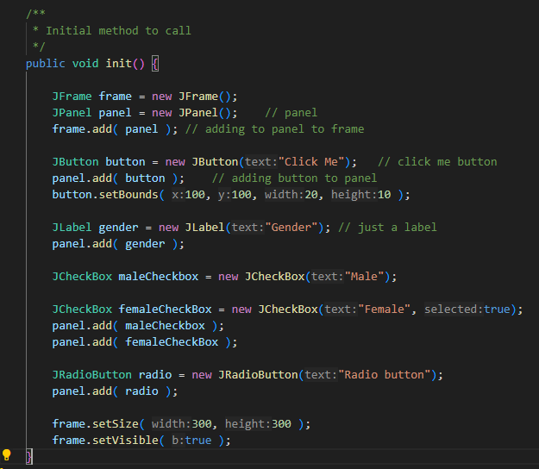
Implementation

Slide 12
Summary
In summary, Java swing also called swing is a powerful GUI toolkit for java applications.
It has many components.
Swing applications are platform independent
It follows MVC architecture

